Slide 1
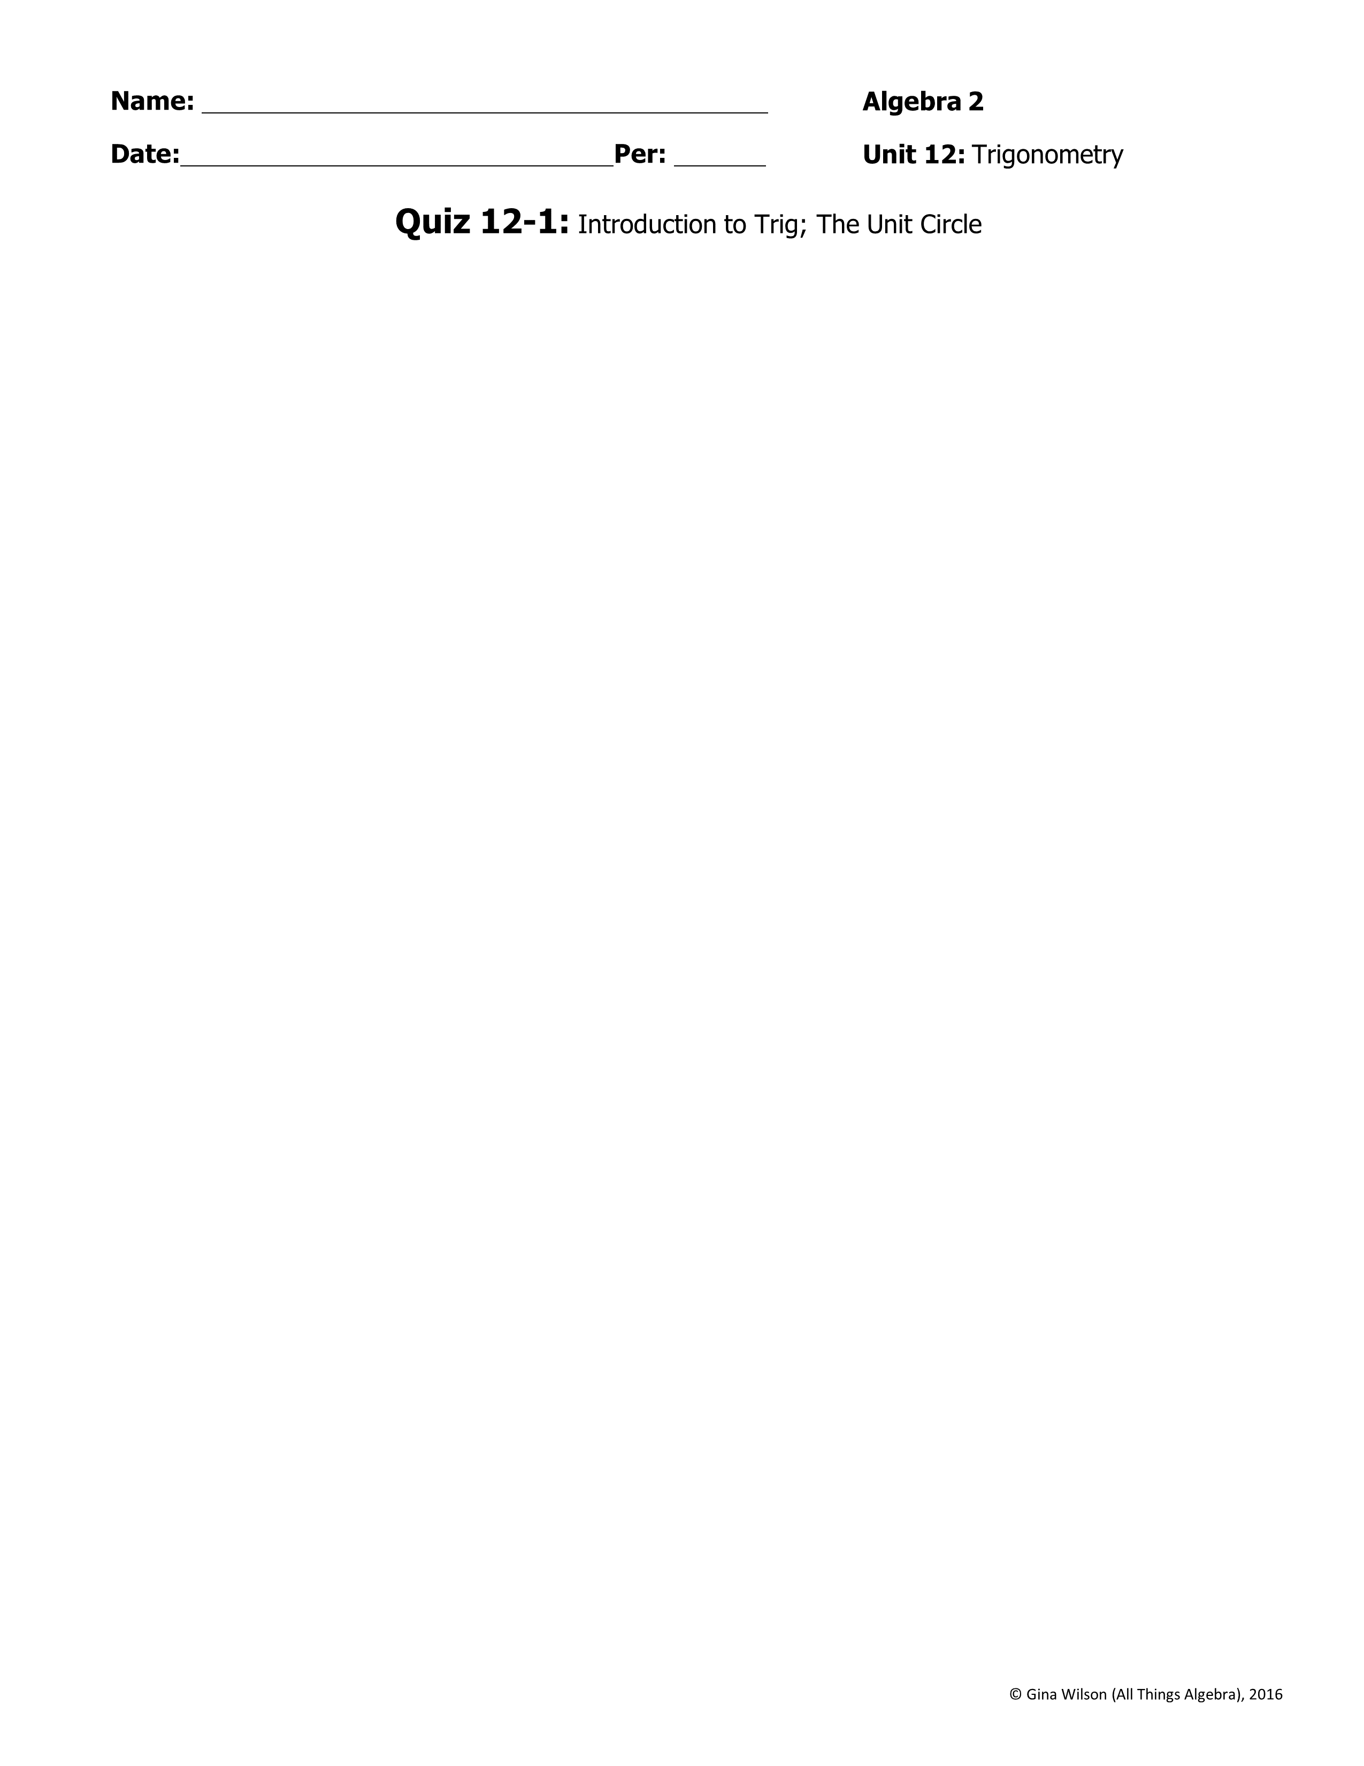
1. Find the values of the six trigonometric functions for angle θ. Give answers in simplest form.
= ________ | = ________
= ________ | = ________
= ________ | = ________
24
2. If ,find the remaining trigonometric functions.
= ________ | = ________
= ________ | = ________
= ________
Find the missing side lengths. Round all answers to the nearest tenth.
3.
25°
4.
17
3.
31
x
48°
4.
x
Find the measure of . Round all answers to the nearest tenth.
5.
6.
5.
17
31
6.
.11
18
42
7. Beth is flying a kite with 300 feet of string. The kite gets stuck in a tree, so she ties the other end of the string to a rock on the ground making the string taut. The angle of elevation from the rock to kite is 35°. How far up the tree is the kite? Round your answer to the nearest tenth.
7.

Slide 2

Give each degree measure in radians and each radian measure in degrees.
8. 130°
9. -285°
8.
9.
10.
11.
10.
11. __________
Give two coterminal angles (one positive and one negative) and the reference angle.
12. 290°
12. Coterminal ∠’s: ________________________ Reference ∠: ___________
13.
13. Coterminal ∠’s: ________________________ Reference ∠: ___________
14. The terminal side of an angle in standard form passes through the point (6, -4). Make a sketch, then find each function value.
y
= ________ | = ________
= ________ | = ________
= ________ | = ________
x
15. If and which quadrant(s) could the terminal side of lie?
15.
Find the exact value for each trigonometric function.
16. tan 135°
17. csc 240°
18. sin 120°
16.
17.
18.
19.
20.
21.
19.
20.
21.

